Slide 1

Fundamentals of IT
BIT-01 B Tech-Ist year MMMUT, Gorakhpur
A
PDF on UNIT-3
Operating System

Slide 2
An operating system (OS) is a collection of software that manages computer hardware resources and provides common services for computer programs. The operating system is a vital component of the system software in a computer system. This tutorial will take you through step-by-step approach while learning Operating System concepts.
Why to Learn Operating System?
An Operating System (OS) is an interface between a computer user and computer hardware. An operating system is a software which performs all the basic tasks like file management, memory management, process management, handling input and output, and controlling peripheral devices such as disk drives and printers.
Some popular Operating Systems include Linux Operating System, Windows Operating System, VMS, OS/400, AIX, z/OS, etc.
Following are some of important functions of an operating System.
Memory Management
Processor Management
Device Management
File Management
Security
Control over system performance
Job accounting
Error detecting aids
Coordination between other software and users.

Slide 3
Applications of Operating System
Following are some of the important activities that an Operating System performs −
Security − By means of password and similar other techniques, it prevents unauthorized access to programs and data.
Control over system performance − Recording delays between request for a service and response from the system.
Job accounting − Keeping track of time and resources used by various jobs and users.
Error detecting aids − Production of dumps, traces, error messages, and other debugging and error detecting aids.
Coordination between other softwares and users − Coordination and assignment of compilers, interpreters, assemblers and other software to the various users of the computer systems.

Slide 4
Important functions of an operating System:
Security – The operating system uses password protection to protect user data and similar other techniques. it also prevents unauthorized access to programs and user data.
Control over system performance – Monitors overall system health to help improve performance. records the response time between service requests and system response to have a complete view of the system health. This can help improve performance by providing important information needed to troubleshoot problems.
Job accounting – Operating system Keeps track of time and resources used by various tasks and users, this information can be used to track resource usage for a particular user or group of user.
Error detecting aids – Operating system constantly monitors the system to detect errors and avoid the malfunctioning of computer system.

Slide 5
Coordination between other software and users –
Operating systems also coordinate and assign interpreters, compilers, assemblers and other software to the various users of the computer systems.
Memory Management –
The operating system manages the Primary Memory or Main Memory. Main memory is made up of a large array of bytes or words where each byte or word is assigned a certain address. Main memory is a fast storage, and it can be accessed directly by the CPU. For a program to be executed, it should be first loaded in the main memory. An Operating System performs the following activities for memory management: It keeps tracks of primary memory, i.e., which bytes of memory are used by which user program. The memory addresses that have already been allocated and the memory addresses of the memory that has not yet been used. In multi programming, the OS decides the order in which process are granted access to memory, and for how long. It Allocates the memory to a process when the process requests it and deallocates the memory when the process has terminated or is performing an I/O operation.
Processor Management –
In a multi programming environment, the OS decides the order in which processes have access to the processor, and how much processing time each process has. This function of OS is called process scheduling. An Operating System performs the following activities for processor management. Keeps tracks of the status of processes. The program which perform this task is known as traffic controller. Allocates the CPU that is processor to a process. De-allocates processor when a process is no more required.

Slide 6
Device Management –
An OS manages device communication via their respective drivers. It performs the following activities for device management. Keeps tracks of all devices connected to system. designates a program responsible for every device known as the Input/Output controller. Decides which process gets access to a certain device and for how long. Allocates devices in an effective and efficient way. Deallocates devices when they are no longer required.
File Management –
A file system is organized into directories for efficient or easy navigation and usage. These directories may contain other directories and other files. An Operating System carries out the following file management activities. It keeps track of where information is stored, user access settings and status of every file and more… These facilities are collectively known as the file system.

Slide 7
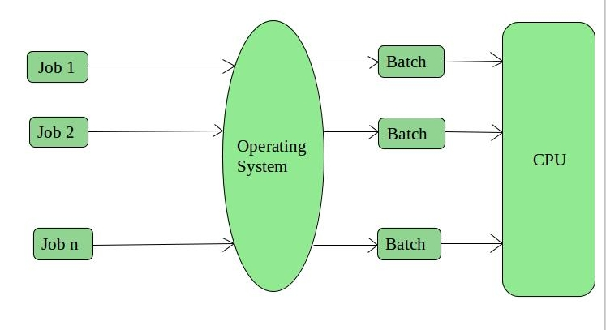
Types of Operating Systems: Some widely used operating systems are as follows-
1. Batch Operating System – This type of operating system does not interact with the computer directly. There is an operator which takes similar jobs having the same requirement and group them into batches. It is the responsibility of the operator to sort jobs with similar needs.

Slide 8
Advantages of Batch Operating System: It is very difficult to guess or know the time required for any job to complete. Processors of the batch systems know how long the job would be when it is in queue
Multiple users can share the batch systems
The idle time for the batch system is very less
It is easy to manage large work repeatedly in batch systems
Disadvantages of Batch Operating System:
The computer operators should be well known with batch systems
Batch systems are hard to debug
It is sometimes costly
The other jobs will have to wait for an unknown time if any job fails
Examples of Batch based Operating System: Payroll System, Bank Statements, etc.

Slide 9
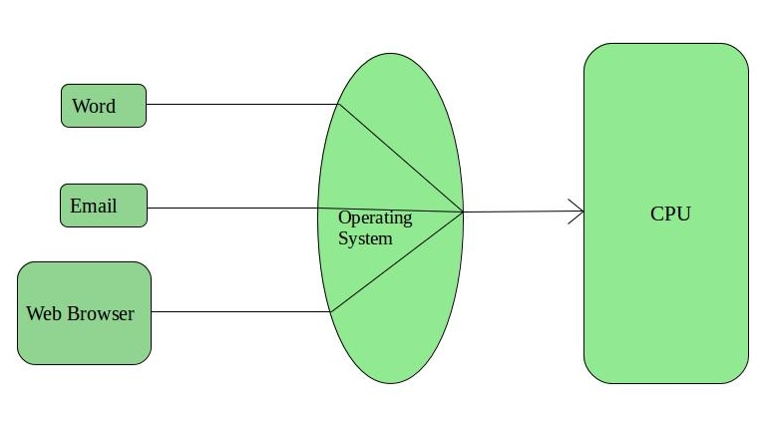
2. Time-Sharing Operating Systems – Each task is given some time to execute so that all the tasks work smoothly. Each user gets the time of CPU as they use a single system. These systems are also known as Multitasking Systems. The task can be from a single user or different users also. The time that each task gets to execute is called quantum. After this time interval is over OS switches over to the next task.

Slide 10
Advantages of Time-Sharing OS:
Each task gets an equal opportunity
Fewer chances of duplication of software
CPU idle time can be reduced
Disadvantages of Time-Sharing OS:
Reliability problem
One must have to take care of the security and integrity of user programs and data
Data communication problem
Examples of Time-Sharing OSs are: Multics, Unix, etc.

Slide 11
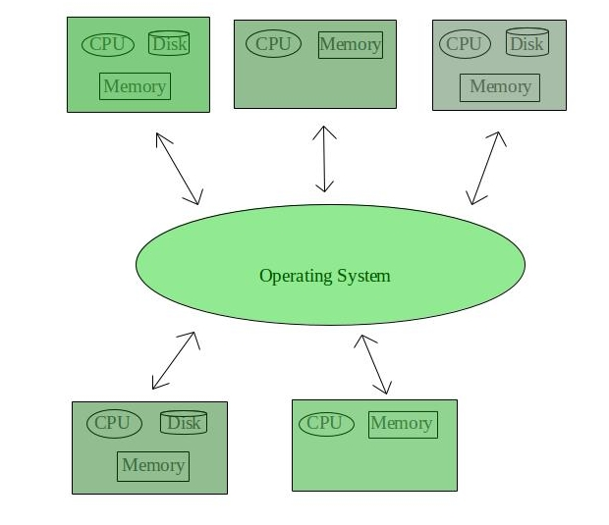
3. Distributed Operating System –
Various autonomous interconnected computers communicate with each other using a shared communication network. Independent systems possess their own memory unit and CPU. These are referred to as loosely coupled systems or distributed systems. These system’s processors differ in size and function. The major benefit of working with these types of the operating system is that it is always possible that one user can access the files or software which are not actually present on his system, but some other system connected within this network i.e., remote access is enabled within the devices connected in that network.

Slide 12
Advantages of Distributed Operating System:
Failure of one will not affect the other network communication, as all systems are independent from each other
Electronic mail increases the data exchange speed
Since resources are being shared, computation is highly fast and durable
Load on host computer reduces
These systems are easily scalable as many systems can be easily added to the network
Delay in data processing reduces
Disadvantages of Distributed Operating System:
Failure of the main network will stop the entire communication
To establish distributed systems the language which is used are not well defined yet
These types of systems are not readily available as they are very expensive. Not only that the underlying software is highly complex and not understood well yet
Examples of Distributed Operating System are- LOCUS, etc.

Slide 13
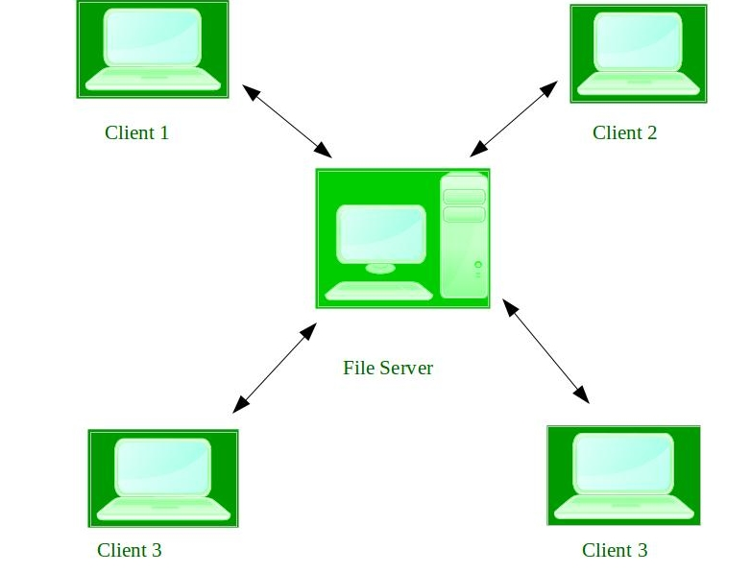
4. Network Operating System –
These systems run on a server and provide the capability to manage data, users, groups, security, applications, and other networking functions. These types of operating systems allow shared access of files, printers, security, applications, and other networking functions over a small private network. One more important aspect of Network Operating Systems is that all the users are well aware of the underlying configuration, of all other users within the network, their individual connections, etc. and that’s why these computers are popularly known as tightly coupled systems.

Slide 14
Advantages of Network Operating System:
Highly stable centralized servers
Security concerns are handled through servers
New technologies and hardware up-gradation are easily integrated into the system
Server access is possible remotely from different locations and types of systems
Disadvantages of Network Operating System:
Servers are costly
User has to depend on a central location for most operations
Maintenance and updates are required regularly
Examples of Network Operating System are: Microsoft Windows Server 2003, Microsoft Windows Server 2008, UNIX, Linux, Mac OS X, Novell NetWare, and BSD, etc.

Slide 15
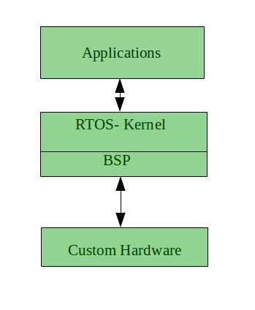
5. Real-Time Operating System – These types of OSs serve real-time systems. The time interval required to process and respond to inputs is very small. This time interval is called response time.
Real-time systems are used when there are time requirements that are very strict like missile systems, air traffic control systems, robots, etc.
Two types of Real-Time Operating System which are as follows:
Hard Real-Time Systems: These OSs are meant for applications where time constraints are very strict and even the shortest possible delay is not acceptable. These systems are built for saving life like automatic parachutes or airbags which are required to be readily available in case of any accident. Virtual memory is rarely found in these systems.
Soft Real-Time Systems: These OSs are for applications where for time-constraint is less strict.

Slide 16
Advantages of RTOS:
Maximum Consumption: Maximum utilization of devices and system, thus more output from all the resources
Task Shifting: The time assigned for shifting tasks in these systems are very less. For example, in older systems, it takes about 10 microseconds in shifting one task to another, and in the latest systems, it takes 3 microseconds.
Focus on Application: Focus on running applications and less importance to applications which are in the queue.
Real-time operating system in the embedded system: Since the size of programs are small, RTOS can also be used in embedded systems like in transport and others.
Error Free: These types of systems are error-free.
Memory Allocation: Memory allocation is best managed in these types of systems.
Disadvantages of RTOS:
Limited Tasks: Very few tasks run at the same time and their concentration is very less on few applications to avoid errors.
Use heavy system resources: Sometimes the system resources are not so good and they are expensive as well.
Complex Algorithms: The algorithms are very complex and difficult for the designer to write on.
Device driver and interrupt signals: It needs specific device drivers and interrupts signals to respond earliest to interrupts.
Thread Priority: It is not good to set thread priority as these systems are very less prone to switching tasks.
Examples of Real-Time Operating Systems are: Scientific experiments, medical imaging systems, industrial control systems, weapon systems, robots, air traffic control systems, etc.

Slide 17
Single-user/Multi-user operating system

Slide 18
A Single-User Operating System is a system in which only one user can access the computer system at a time.
A Multi-User Operating System is a system that allows more than one user to access a computer system at one time.
User 1
System
User 1
User 2
System
User n

Slide 19
CHARACTERISTICS | SINGLE-USER OPERATING SYSTEM | MULTI-USER OPERATING SYSTEM
Definition | A Single-User Operating System is a system in which only one user can access the computer system at a time. | A Multi-User Operating System is a system that allows more than one user to access a computer system at one time.
Super User | A super user gets all the powers of maintaining the system and making changes to ensure the system runs smoothly. | Super user does not exist when it comes to a multi-user operating system as each entity has control over their working.
Complexity | Single-User Operating System is simple. | Multi-User Operating System is complex.
Performance | Only one task at one time gets performed. | Schedules different tasks for performance at any rate
Example | Windows, Apple Mac OS | UNIX, Linux and Mainframes

Slide 20
Introduction to Linux Shell
If you are using any major operating system you are indirectly interacting to shell. If you are running Ubuntu, Linux Mint or any other Linux distribution, you are interacting to shell every time you use terminal.
Kernel
Shell
Terminal

Slide 21
What is Kernel
The kernel is a computer program that is the core of a computer’s operating system, with complete control over everything in the system. It manages following resources of the Linux system –
File management
Process management
I/O management
Memory management
Device management etc.
It is often mistaken that Linus Torvalds has developed Linux OS, but actually he is only responsible for development of Linux kernel. Complete Linux system = Kernel + GNU system utilities and libraries + other management scripts + installation scripts.

Slide 22
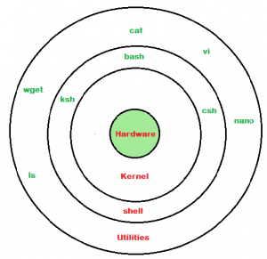
What is Shell
A shell is special user program which provide an interface to user to use operating system services. Shell accept human readable commands from user and convert them into something which kernel can understand. It is a command language interpreter that execute commands read from input devices such as keyboards or from files. The shell gets started when the user logs in or start the terminal.

Slide 23
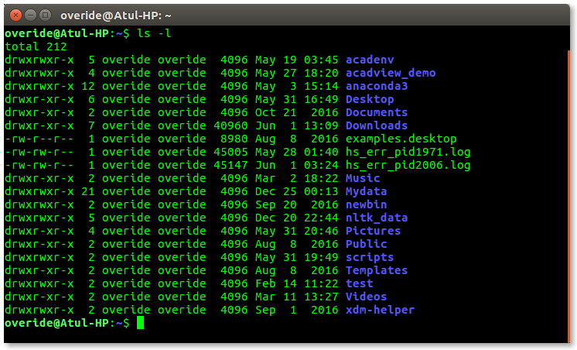
Shell is broadly classified into two categories –
Command Line Shell
Graphical shell
Command Line Shell
Shell can be accessed by user using a command line interface. A special program called Terminal in linux/macOS or Command Prompt in Windows OS is provided to type in the human readable commands such as “cat”, “ls” etc. and then it is being execute. The result is then displayed on the terminal to the user. A terminal in Ubuntu 16.4 system looks like this –

Slide 24
In above screenshot “ls” command with “-l” option is executed.It will list all the files in current working directory in long listing format. Working with command line shell is bit difficult for the beginners because it’s hard to memorize so many commands. It is very powerful, it allows user to store commands in a file and execute them together. This way any repetitive task can be easily automated. These files are usually called batch files in Windows and Shell Scripts in Linux/macOS systems.
Graphical Shells
Graphical shells provide means for manipulating programs based on graphical user interface (GUI), by allowing for operations such as opening, closing, moving and resizing windows, as well as switching focus between windows. Window OS or Ubuntu OS can be considered as good example which provide GUI to user for interacting with program. User do not need to type in command for every actions.A typical GUI in Ubuntu system –

Slide 25
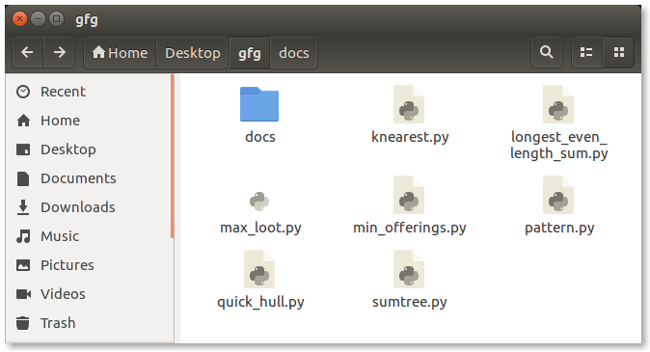

Slide 26
The UNIX system is command-based i.e things happen because of the commands that you key in. All UNIX commands are seldom more than four characters long. They are grouped into two categories:
Internal Commands : Commands which are built into the shell. For all the shell built-in commands, execution of the same is fast in the sense that the shell doesn’t have to search the given path for them in the PATH variable, and also no process needs to be spawned for executing it. Examples: source, cd, fg, etc.
External Commands : Commands which aren’t built into the shell. When an external command has to be executed, the shell looks for its path given in the PATH variable, and also a new process has to be spawned and the command gets executed. They are usually located in /bin or /usr/bin. For example, when you execute the “cat” command, which usually is at /usr/bin, the executable /usr/bin/cat gets executed. Examples: ls, cat etc

Slide 27
Difference between Primary and Secondary Memory

Slide 28
Computer Memories store data and instruction. Memory system can be divided into 4 categories:
CPU register: In Computer Architecture, the Registers are very fast computer memory which are used to execute programs and operations efficiently. This does by giving access to commonly used values, i.e., the values which are in the point of operation/execution at that time. So, for this purpose, there are several different classes of CPU registers which works in coordination with the computer memory to run operations efficiently. The sole purpose of having register is fast retrieval of data for processing by CPU.
Cache memory: Cache memory is a very high speed semiconductor memory which can speed up the CPU. It acts as a buffer between the CPU and the main memory. It is used to hold those parts of data and program which are most frequently used by the CPU. The parts of data and programs are transferred from the disk to cache memory by the operating system, from where the CPU can access them.

Slide 29
Primary / Main memory:
Primary memory is the computer memory that is directly accessible by CPU. It is comprised of DRAM and provides the actual working space to the processor. It holds the data and instructions that the processor is currently working on.
Secondary Memory / Mass Storage:
The contents of the secondary memory first get transferred to the primary memory and then are accessed by the processor, this is because the processor does not directly interact with the secondary memory.

Slide 30
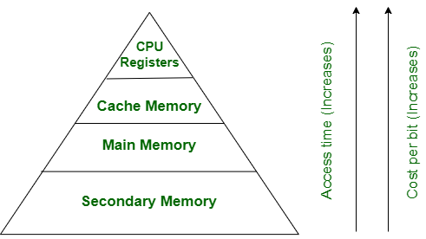
They can be represented in an hierarchical form as:

Slide 31
Sr.No. | Primary memory | Secondary memory
1. | Primary memory is temporary. | Secondary memory is permanent.
2. | Primary memory is directly accessible by Processor/CPU. | Secondary memory is not directly accessible by the CPU.
3. | Nature of Parts of Primary memory varies, RAM- volatile in nature. ROM- Non-volatile. | It’s always Non-volatile in nature.
4. | Primary memory devices are more expensive than secondary storage devices. | Secondary memory devices are less expensive when compared to primary memory devices.
5. | The memory devices used for primary memory are semiconductor memories. | The secondary memory devices are magnetic and optical memories.
6. | Primary memory is also known as Main memory or Internal memory. | Secondary memory is also known as External memory or Auxiliary memory.
7. | Examples: RAM, ROM, Cache memory, PROM, EPROM, Registers, etc. | Examples: Hard Disk, Floppy Disk, Magnetic Tapes, etc.

